Slide 1

Philadelphia Water Department
South Street
Water Main Replacement Project Update
Wednesday, May 20, 2026 | 10AM
South Street Headhouse District Monthly Business Meeting

Slide 2
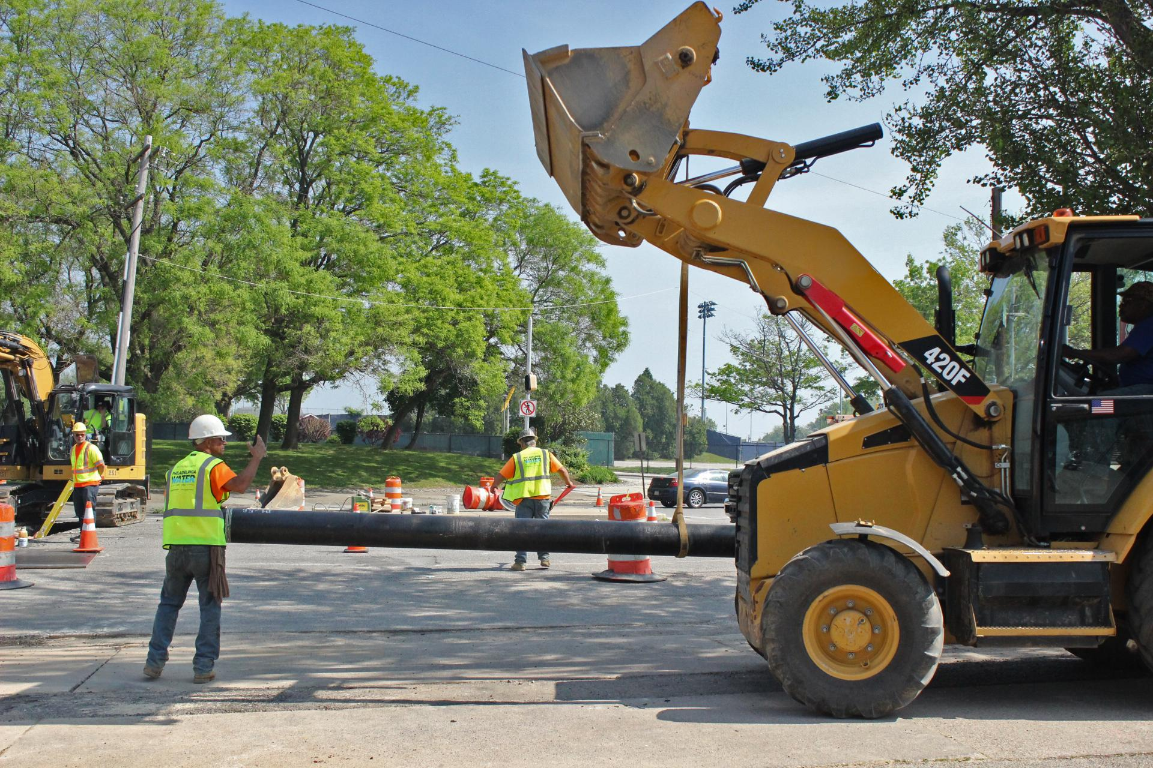
Agenda
What: Project Overview
Why does PWD do this work?
When/Where: What does construction look like?
Who: To Contact
Resources & Questions
SSHD 5.20.26

Slide 3
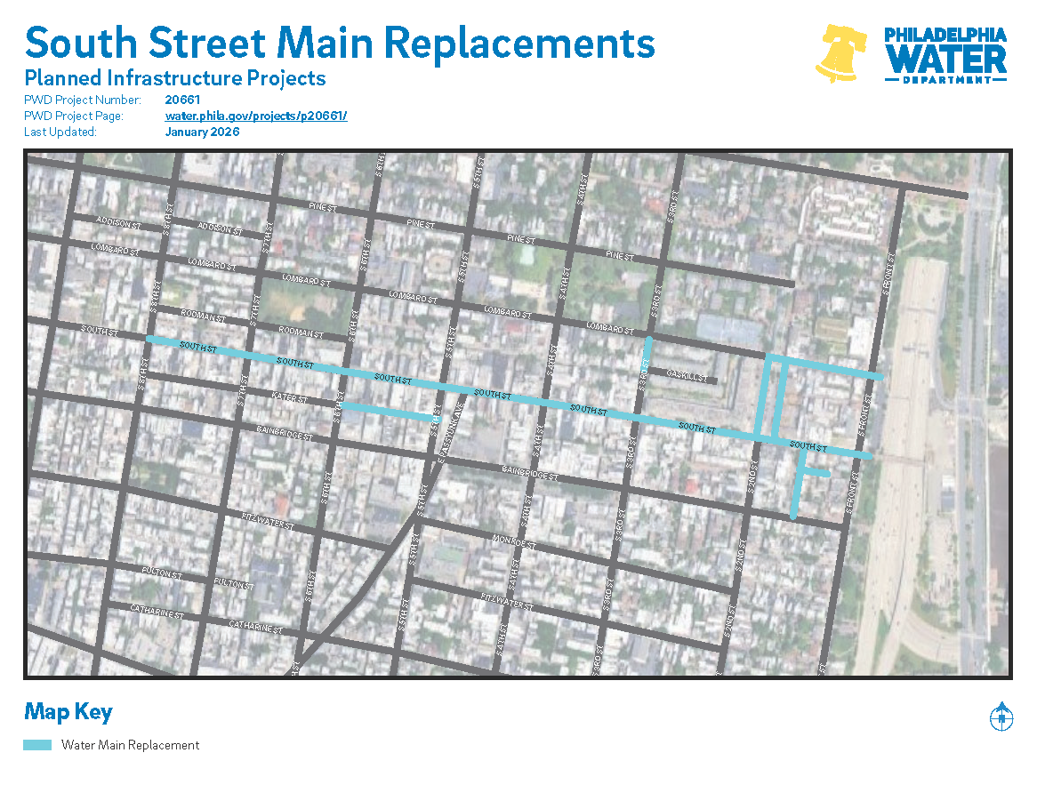
Projects in Your Area
PWD Project #20661 South Street
Water main replacements and lead service line replacements
water.phila.gov/south-st
Notes:
*Remove if adding to a GSI/Integrated Presentation*

Slide 4
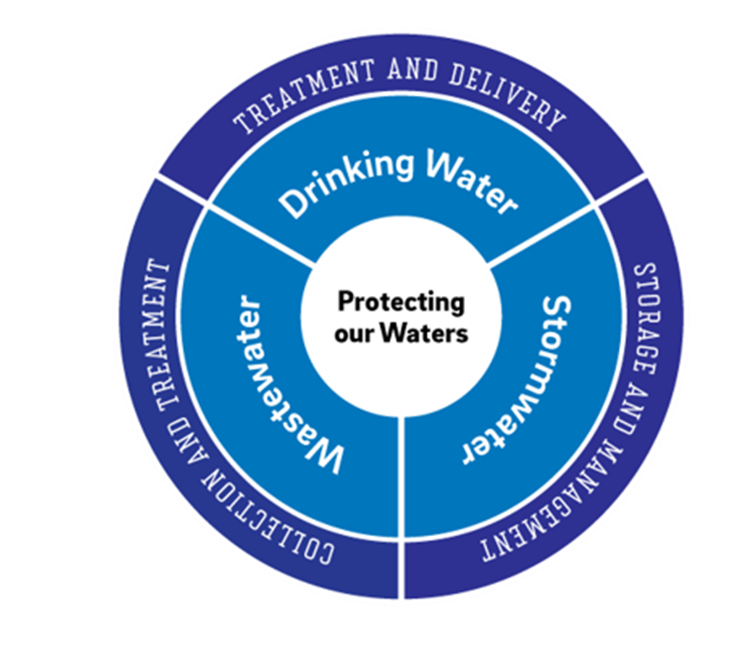
Why does PWD do this work?
PWD plans and implements Capital Projects to upgrade infrastructure for 3 core areas of service
Drinking Water → New Water Mains & Lead Service Lines
Wastewater → New Sewers
Stormwater → Green Stormwater Infrastructure (GSI)
SSHD 5.20.26
Notes:
*Remove if adding to a GSI/Integrated Presentation*
New water mains are installed to increase service reliability of water coming into your homes
During this work we offer lead service line replacement for eligible properties with confirmed lead service lines
New sewers installed (or sewer lining work) to increase system capacity of water coming out of your homes
New Green Stormwater Infrastructure Systems is installed to prevent combined stormwater / sewer overflows and protect our waterways
We use risk assessment tools to review age, condition of pipes, and impacts of break, to determine which pipes need upgrades next

Slide 5
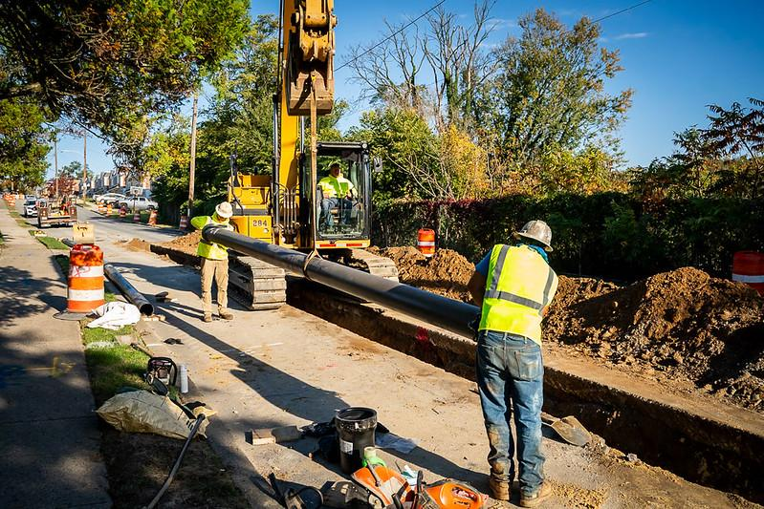
Water Main Replacement
Aging water mains are replaced to increase drinking water service reliability
Reduces number of emergency breaks and leaks
SSHD 5.20.26

Slide 6
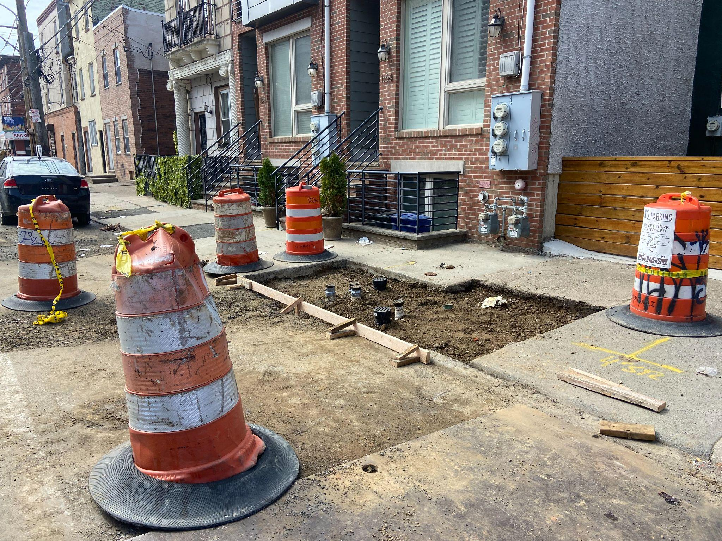
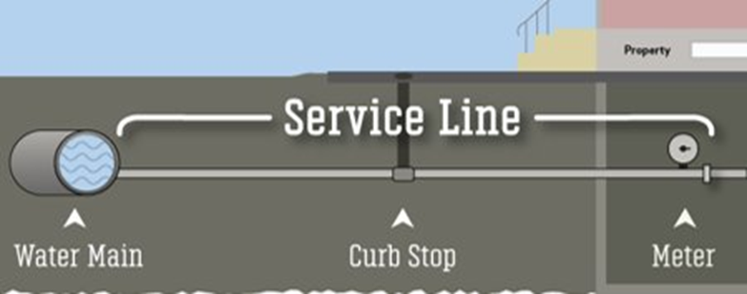
Lead Service Line Replacement
PWD water mains connect to residential service lines
During work, we will replace any lead or galvanized metal service lines connected to new main
Free service
Owned by the property owner: we need homeowners’ approval
Fill
Notes:
As part of the water main work, we have to connect to properties’ service lines - this will cause a loss of water for a few hours
When we make connections, if we find lead service lines, owned by residents, we will replace them for free
But because they are owned by homeowners, we need approval via a permission form that will be mailed to you in a few weeks. Inspector also has authorization forms and will knock on doors if lead is found.

Slide 7
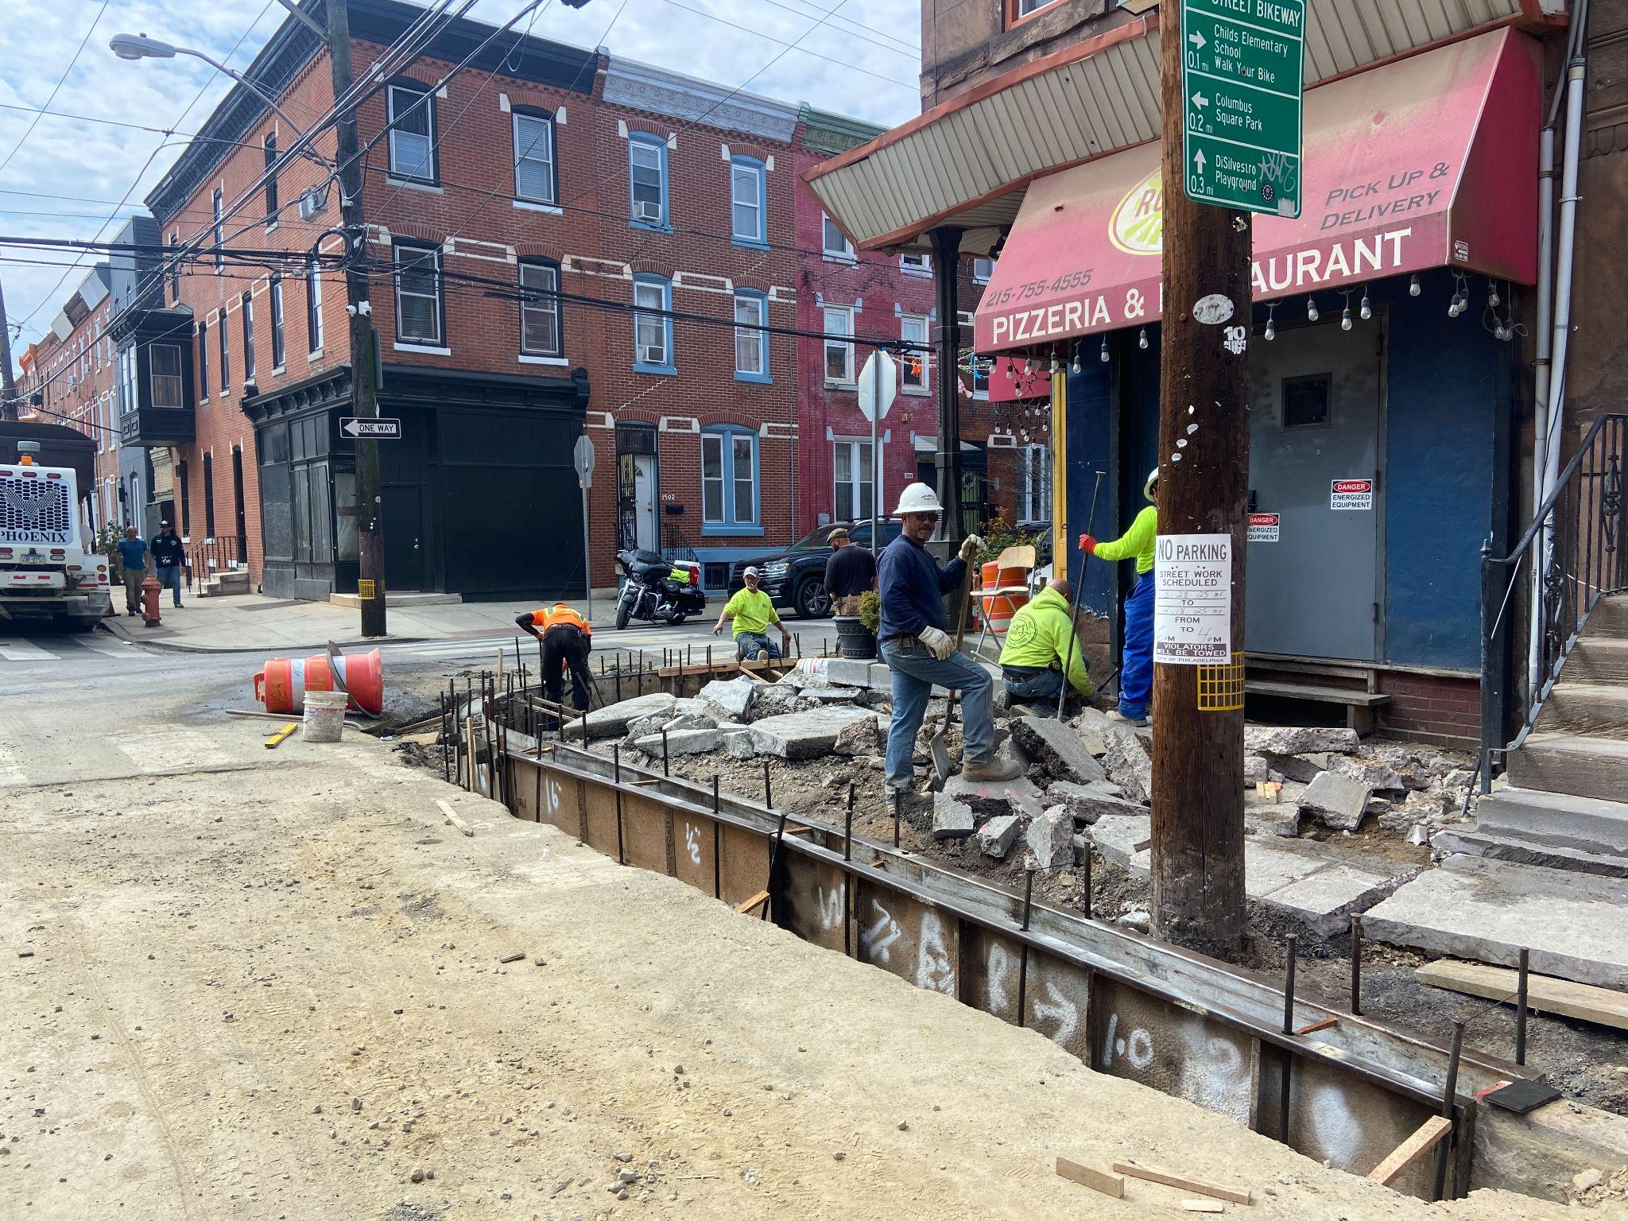
Work Starts in Late Summer 2026
Contractor will provide monthly schedule
Work is done 1 block at a time, ~4-6 weeks per block
Expect work through Fall 2027
Water shutoffs for service line and pipe connections (tie-ins): Planned and given advance notice
SSHD 5.20.26
Notes:
Water main replacement on Germantown Ave should still be occurring in May.
Gas work will begin in Master St from Germantown to 9th street around May also.

Slide 8
What we know now:
What we will learn later:
Work largely within street; some sidewalks affected
Contractor will work with businesses to avoid shut offs during open hours
Temporary no parking and street closures
Large trucks and equipment
Other utilities coordination underway
Block by block schedule
Specifics of water loss timing
If streets require full closure or just lane closure
SSHD 5.20.26
Notes:
What will this work look like in your neighborhood?
Trenches in streets to access the pipes, closed off at night
Contracted crews performing work from 7am-4pm most days - there are times where they will take breaks and come back
Occasional service shutoffs for service connections
Loss of parking and streets closures from 7am-4pm
Large trucks and equipment in area

Slide 9

Contact the PWD Inspector or Project Manager for on-site help
How to Find This Info
Letters - check your mail!
PWD Project Pages - maps and contact info
19147-based project emails: water.phila.gov/projects-news
water.projects@phila.gov
John Cahill
PWD Project Manager for #20661
JPC Group
Hired Contractor
SSHD 5.20.26
OPCA Meeting 10.19.23
Penn Knox Meeting 11.7.23
SSHD Board Meeting 10.16.24

Slide 10
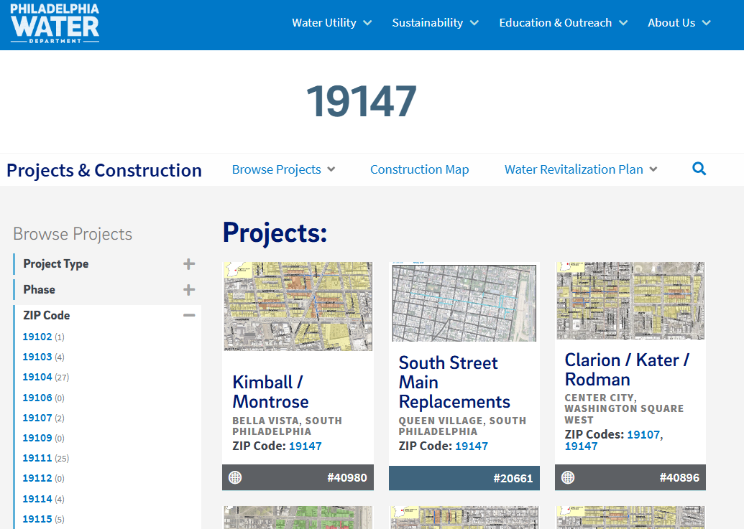
water.phila.gov/projects
OPCA Meeting 10.19.23
Penn Knox Meeting 11.7.23
2.12.26
SSHD Board Meeting 10.16.24
Meeting info and date
Notes:
*Remove if adding to a GSI/Integrated Presentation*

Slide 11
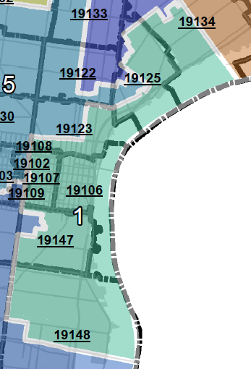
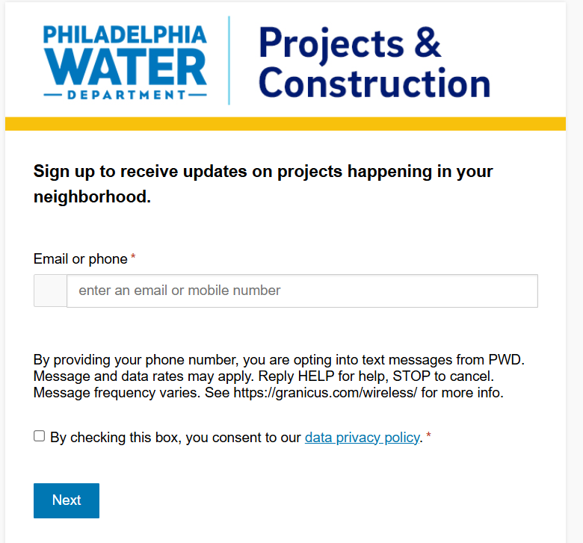
Sign up for the Quarterly Construction Newsletter
water.phila.gov/projects-news
SSHD 5.20.26
Notes:
I send a quarterly newsletter about PWD projects by Council District, using zip codes. These emails share information about PWD Construction coming the districts your zip falls into.
https://water.phila.gov/blog/pwd-quarterly-construction-newsletter-spring-2026/

Slide 12
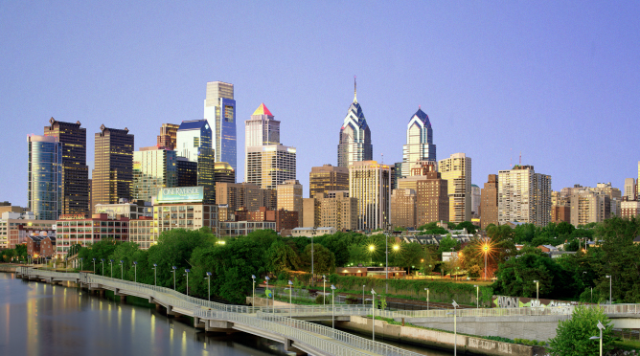

Thank you!
Project Questions & Help:
amy.hopf@phila.gov
Water.Projects@phila.gov
Project Page:
water.phila.gov/south-st

Slide 13
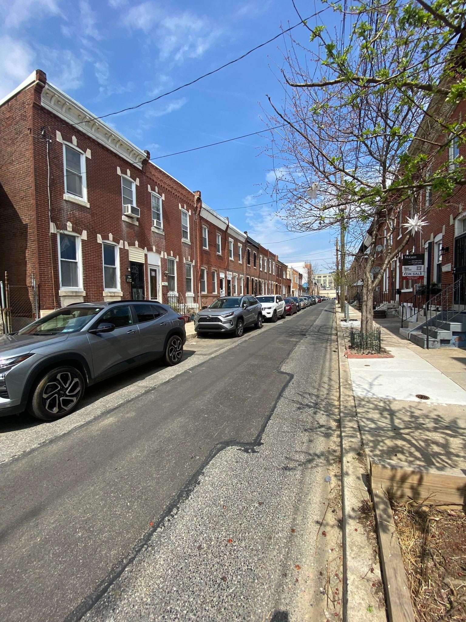
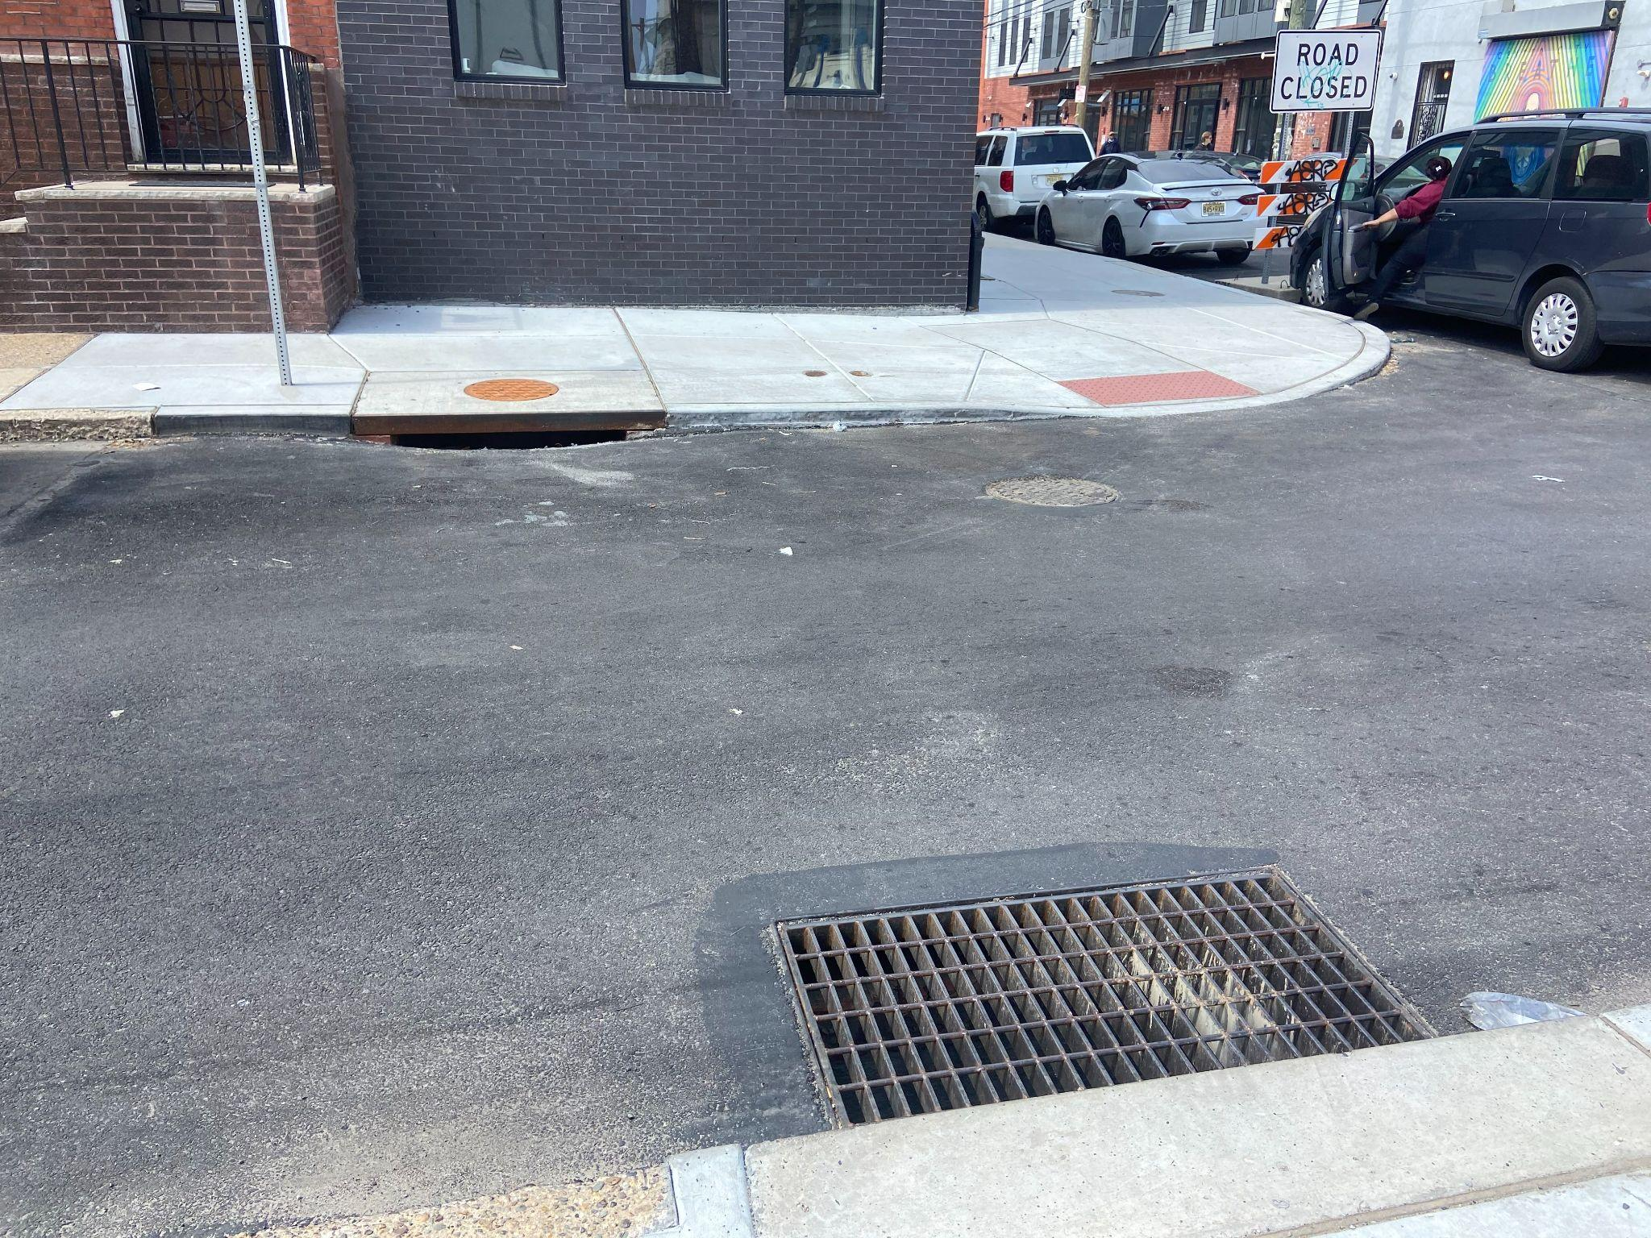
Completed
Notes:
What will this work look like in your neighborhood?
Trenches in streets to access the pipes, closed off at night
Contracted crews performing work from 7am-4pm most days - there are times where they will take breaks and come back
Occasional service shutoffs for service connections
Loss of parking and streets closures from 7am-4pm
Large trucks and equipment in area

